Slide 1
Multi Dimensional Arrays

Slide 2
Multi-dimensional Arrays
CSE 103 : Structured Programming
A[50], B[60] etc are all one-dimensional arrays ( like a single row, multiple column or single column, multiple row )
Arrays can have multiple dimensions ( 2 or more)
2-dimensional arrays have multiple rows and multiple columns (2-d structure)
3-dimensional arrays have multiple rows, multiple columns and multiple depths (3-d structure)
Arrays may have higher dimension. In this course, we’ll focus only on 2-dimensional arrays or matrix.

Slide 3
2-dimensional Arrays
CSE 103 : Structured Programming
A[5][4]
Column
A[0][0] | A[0][1] | A[0][2] | A[0][3]
A[1][0] | A[1][1] | A[1][2] | A[1][3]
A[2][0] | A[2][1] | A[2][2] | A[2][3]
A[3][0] | A[3][1] | A[3][2] | A[3][3]
A[4][0] | A[4][1] | A[4][2] | A[4][3]
5 rows
4 columns
Row

Slide 4
Declaring 2-D Array
CSE 103 : Structured Programming
int a[30][20]
Maximum number of rows
Maximum number of
columns
Both must be constant!!
Declares a matrix that may have maximum 30 rows and maximum 20 columns where all elements are of type integer

Slide 5
Indexing 2D Array
CSE 103 : Structured Programming
Array elements are accessed using index
Arr[0] means 1st row of array Arr.
Arr[0][0] means 1st element (column) of 1st row
…
Arr[0][N-1] means Nth element of 1st row.
Arr[1] means 2nd row of array Arr.
Arr[1][0] means 1st element of 2nd row
…
Arr[M-1] means Mth row of array Arr.
….
Arr[M-1][N-1] means Nth element of Mth row

Slide 6
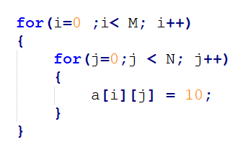
Initializing 2D Array
CSE 103 : Structured Programming
Initializing whole array
int a[3][2];
a[3][2] = {{1,2},{3,4},{5,6}};
Initializing element wise array
Manually :
a[0][1] = 10;
a[0][2]= 10;
a[0][3] = 10;
………………….
Using Loop :

Slide 7
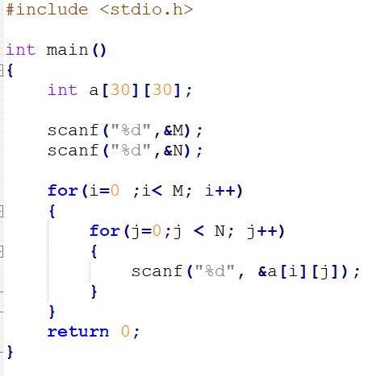
2D Array Input
CSE 103 : Structured Programming
Element wise input
Hence,
M is the total number of rows
N is the total number of columns

Slide 8
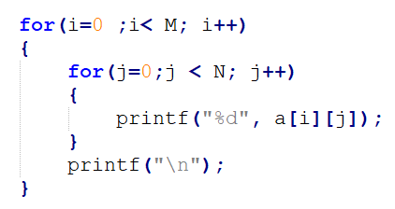
2D Array Print
CSE 103 : Structured Programming
Element wise print
Hence,
M is the total number of rows
N is the total number of columns
Why this newline??

Slide 9
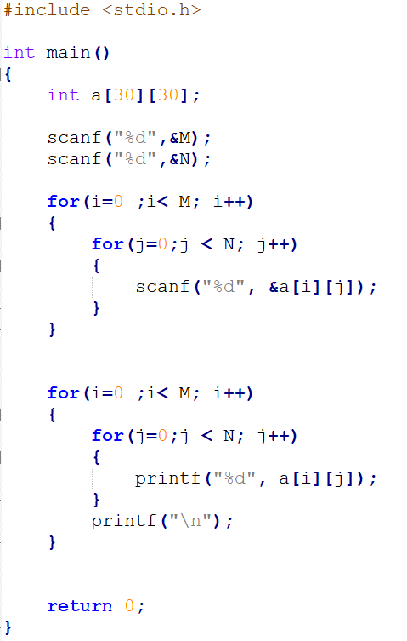
Taking a matrix or 2d array as input and print it
CSE 103 : Structured Programming

Slide 10
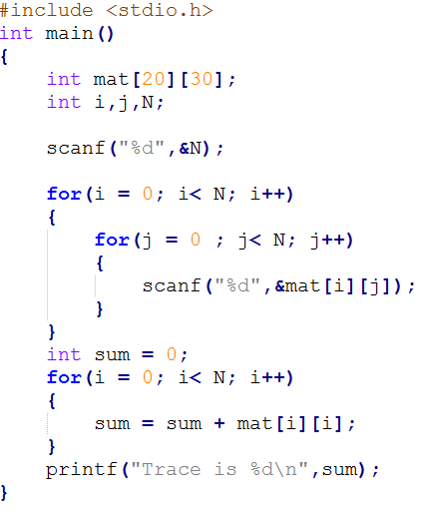
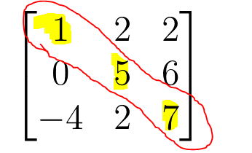
Take a matrix as input and calculate its trace
CSE 103 : Structured Programming
Trace of the matrix = 1 + 5 + 7 = 13

Slide 11
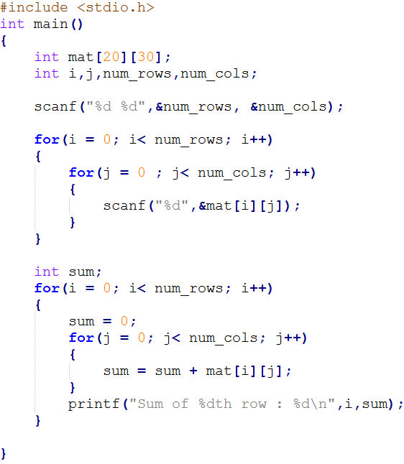
Take a matrix as input and calculate its row-wise sum
CSE 103 : Structured Programming

Slide 12
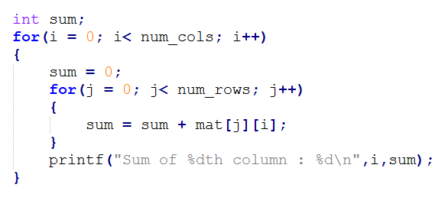
Take a matrix as input and calculate its column-wise sum
CSE 103 : Structured Programming
What’s the change from previous?

Slide 13
Some Problems
CSE 103 : Structured Programming
Calculate minimum element of the matrix
Calculate row-wise minimum of matrix
Calculate column-wise minimum of the matrix
Calculate maximum element of the matrix
Calculate row-wise maximum of matrix
Calculate column-wise maximum of the matrix
Take two matrices as inputs and print their summation matrix

